Slide 1
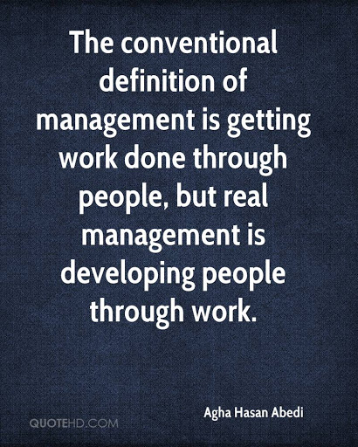
Introduction
Definition of Management
Introduction to Functions of Management
Levels of Management
Management Roles
Types of Businesses
Appreciate the importance of different organisational contexts, academic disciplines and theoretical lenses to practical management

Slide 2
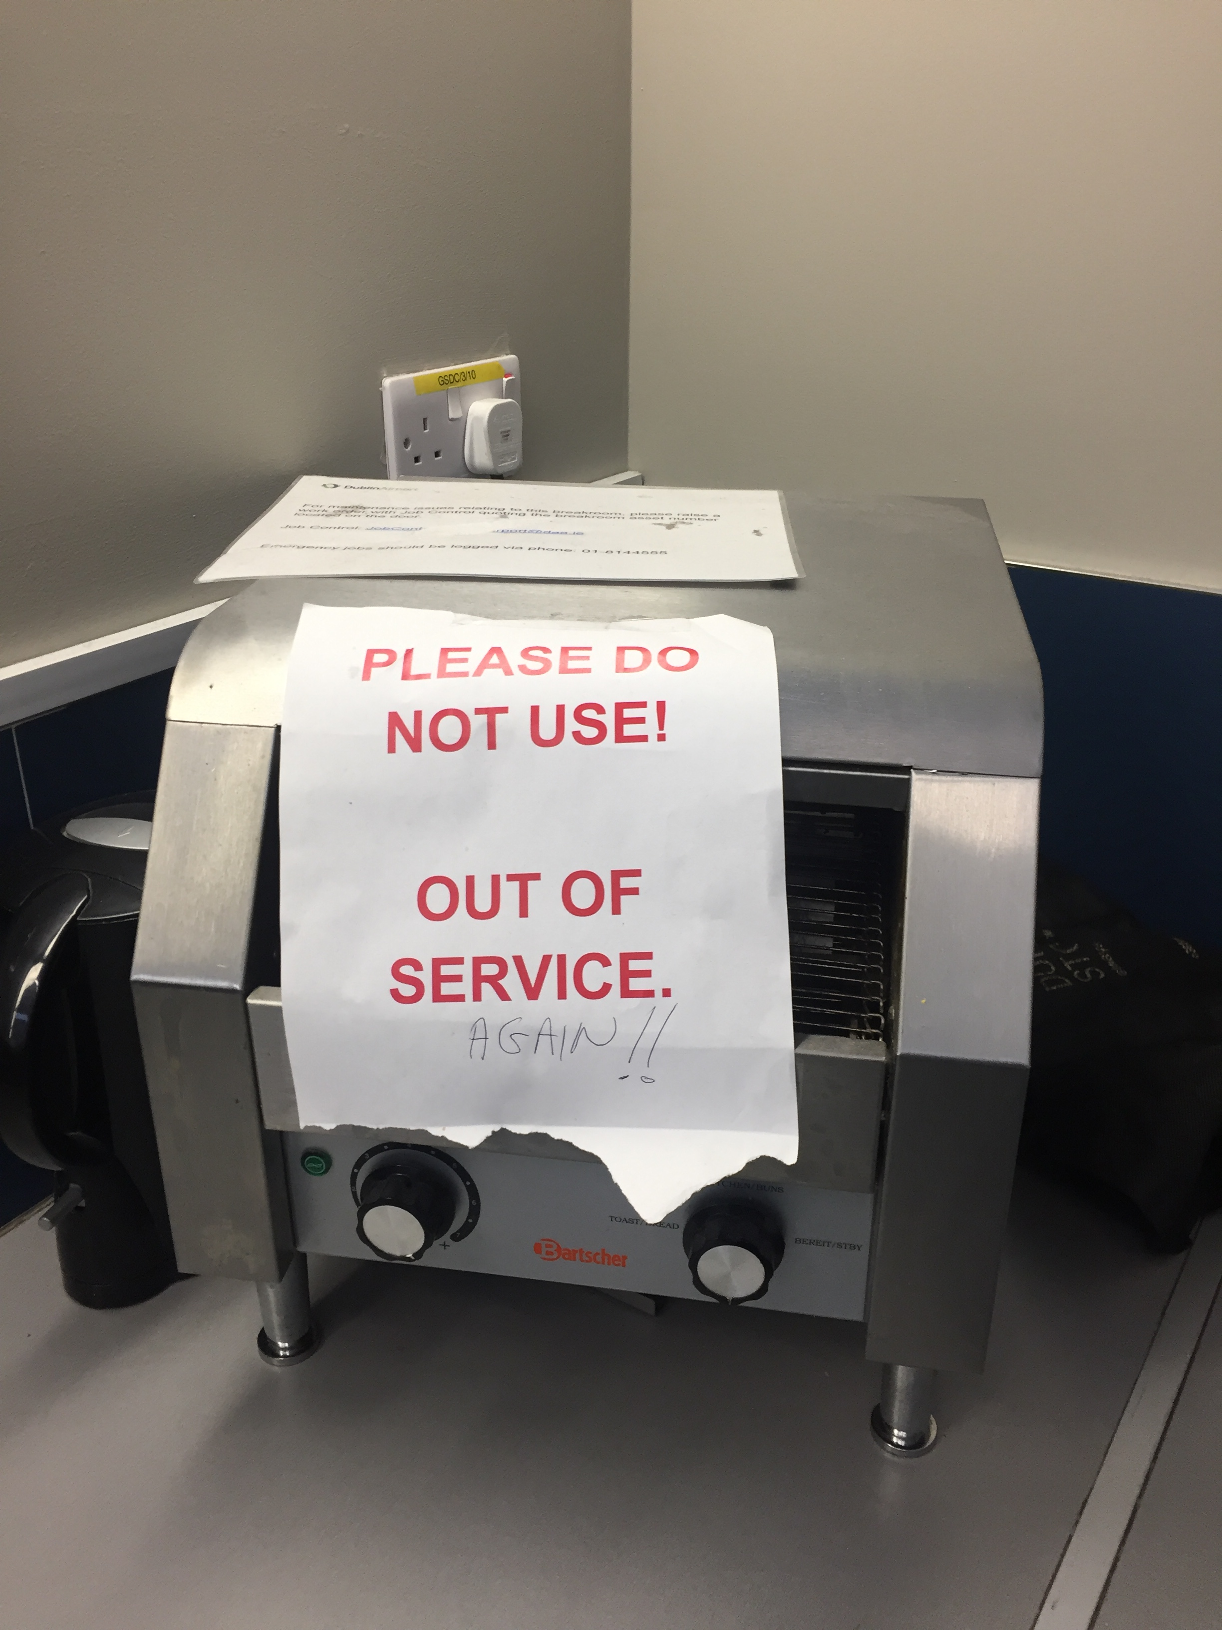

Slide 3
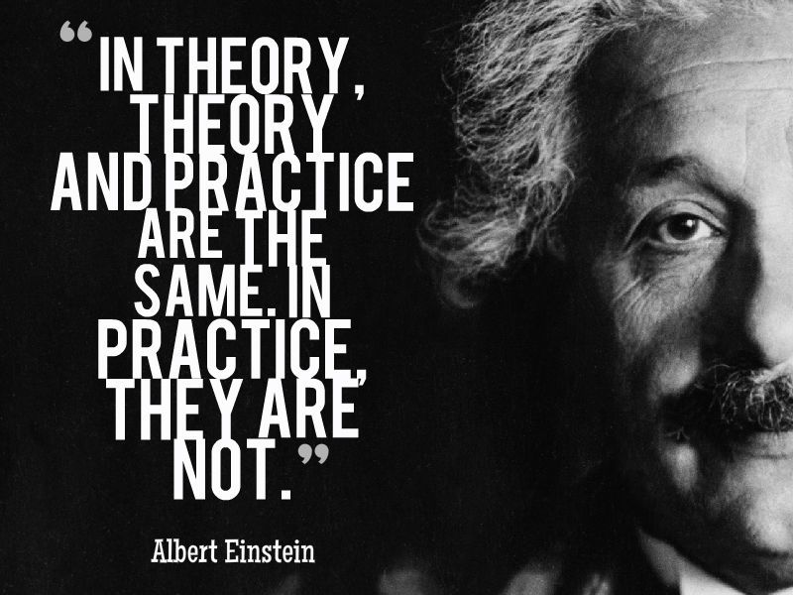
Theory & Practice
“Every practice rests on theory, even if the practitioner themselves are unaware of it” (Drucker, 1986:40)
"…theory is needed precisely because reality is so complicated.“ (Penrose, 1959:11)

Slide 4

Evolution of Management Thought
Management practice is as old as human civilization - people started living together in groups
Every human group requires management and the history of humanity is full of organizational and behavioral activities - the ‘social animal’
However, the study of Management is predominantly a 20th Century phenomena

Slide 5

Evolution of Management Thought
Classical
    Represented by scientific management thought, administrative management and bureaucracy
Behavioural
    Represented human relation movement and behavioural approach
Modern
    Represented quantitative approach, system approach and contingency approach

Slide 6
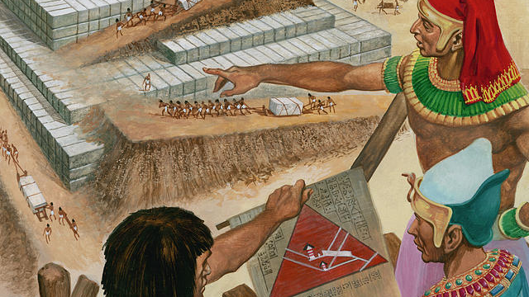
Management Origins
Broad chronological periods;-
1500 BC Egyptians using a number of management techniques;
  planning, organising, controlling, record keeping
1340 Paccioli, ‘the father of accounting’ published a book on Double-entry Bookkeeping
1770 First Industrial Revolution

Slide 7

Modern Management
1870 Second Industrial Revolution
  Emerging requirement for professional manager.
  Separation of ownership and control
1916 “Administration Industrielle et Generale” – Henri Fayol
  Attempt to clarify the range of tasks performed by managers
  Five elements, forecasting & planning; organising; commanding; coordinating; controlling
1973 – Mintzberg
  Management is not about function, it is concerned with what managers actually do

Slide 8
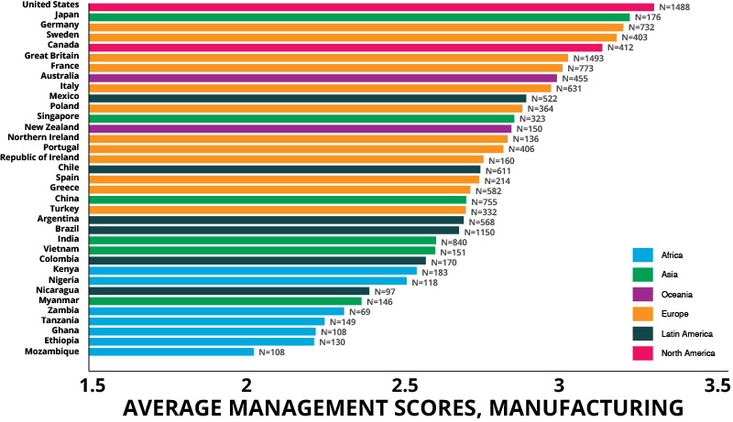
https://worldmanagementsurvey.org/

Slide 9
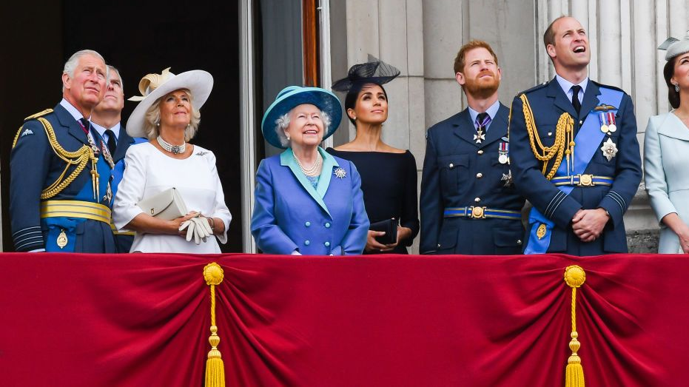
The Firm
What is it?
An administrative unit?
A collection of productive resources?
A collection of competencies?
How does it work?
What makes it work?

Slide 10
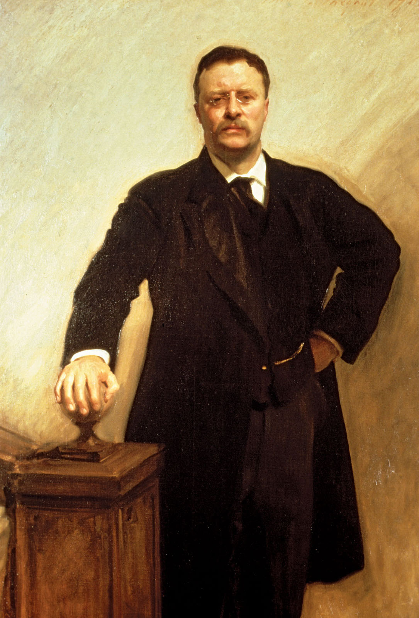
Resources & Competences
Resources
  Are the assets that organisations have or can call upon (e.g. from partners or suppliers)
  ‘What we have’.
Competences
  Are the ways those assets are used or deployed effectively
  ‘What we do well’
A “Resources and Capabilities” analysis is a study about the potential of a company
Instead of focusing on its results, it highlights the tools and internal opportunities a company could use for maximizing its outcome
“The nation behaves well if it treats the natural resources as assets which it must turn over to the next generation increased; and not impaired in value.” (Theodore Roosevelt)

Slide 11
Components of Strategic Capabilities
Strategic Capability |  | Strategic Capability
Resources (what we have) |  | Competences (what we do well)
Machines, raw materials, products, patents, data bases, computer systems | Physical | Ways of achieving utilisation of plant efficiently, productivity, flexibility marketing
Balance sheets, cash flows, suppliers of funds | Financial | Ability to raise funds and manage cash funds, debtor, creditors etc.
Managers, employees, partners, suppliers, customers | Human | How people use and gain experience, skills, knowledge, build relationships, motivate others and innovate
Long-term Survivability and Competitive Advantage |  | Long-term Survivability and Competitive Advantage
Johnson, Whittington, and Scholes, Exploring Strategy, 9th ed., ©Pearson Education Ltd.

Slide 12
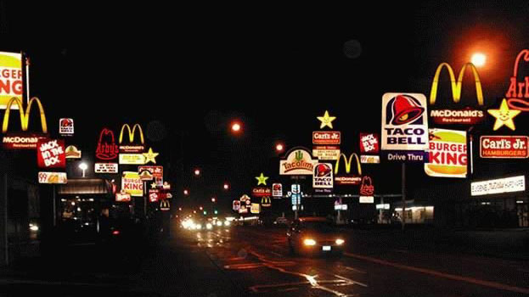
Threshold & Distinctive
Capabilities
Threshold Capabilities
  Are those needed for an organisation to meet the necessary requirements to compete in a given market and achieve parity with competitors in that market
  ‘Qualifiers’
Distinctive Capabilities
  Are those that critically underpin competitive advantage and that others cannot imitate or obtain
  ‘Winners’
Johnson, Whittington, and Scholes, Exploring Strategy, 9th ed., ©Pearson Education Ltd.

Slide 13
Threshold & Distinctive Capabilities
 | Resources | Competences
Threshold Capabilities Required to be able to compete in markets | Distinctive Resources Physical Facilities Financial | Distinctive Resources Design Store layout CSR Supply chain management
Distinctive Capabilities Require to achieve competitive advantage | Distinctive Capabilities Intangible assets Human Resources | Distinctive Competences Culture Replication
Johnson, Whittington, and Scholes, Exploring Strategy, 9th ed., ©Pearson Education Ltd.

Slide 14

Resources & Competences
(Star Wars)
When George Lucas filmed Star Wars (1977), he didn’t have lots of Resources:
Budget was limited
Sponsors were not convinced about the project
Nobody expected Star Wars to succeed
A previous but “similar” franchise, Star Trek, had been disappointing, regarding its results, so Star Wars was expected to be also a failure. The only question was how big
What happened?
  George Lucas filmed one of the best and popular movies ever created
  With very little Resources (compared to nowadays big productions) he was Capable to create a wonderful masterpiece
Some decades later Disney bought Star Wars franchise (2012) for $4 billion
Disney have almost infinite Resources
They decided, of course, to release more Star Wars movies
2015, Disney released “Star Wars episode VII: The force awakens“. The movie was very successful, but 7.5 times the budget of Star Wars
Star Wars episode IV (1977) budget: $11 million – Adjusted to inflation = $46 million.
Star Wars episode VII (2015) budget: $306 million.
Moral of the Story:
Although Disney had much more Resources than George Lucas had 40 years before they were not Capable of producing the masterpiece he created
What about the Box office collection? Maybe Disney’s movie collected more money…
Star Wars episode VII (2015) collected $2 billion worldwide.
Star Wars episode IV (1977) collected $775 million that, adjusted to inflation = $3.2 billion
Source: https://www.consuunt.com/resources-and-capabilities/

Slide 15

What is the role of the Manager?
The Firm
Resources
+
Competencies
Johnson, Whittington, and Scholes, Exploring Strategy, 9th ed., ©Pearson Education Ltd.

Slide 16
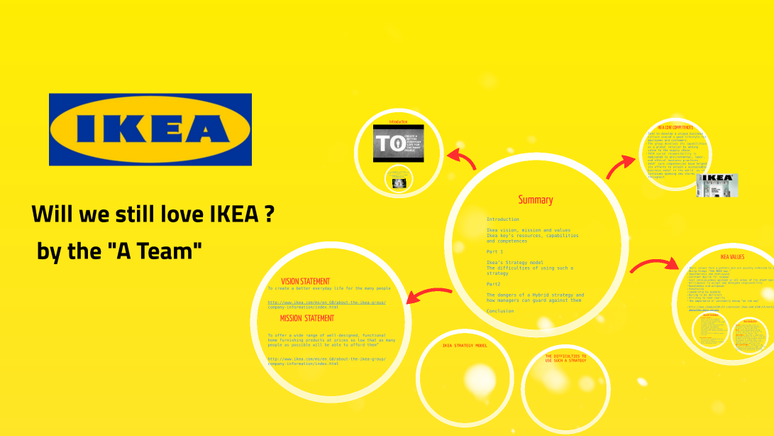
Core Competences
Core competences are the linked set of skills, activities and resources that, together:
  deliver customer value
  differentiate a business from its competitors
  potentially, can be extended and developed as markets change
  or when new opportunities arise
1G. Hamel and C.K. Prahalad, ‘The core competence of the corporation’, Harvard Business Review, vol. 68, no. 3 (1990), pp. 79–91.
Imagine source: https://prezi.com Will we still love Ikea
Johnson, Whittington, and Scholes, Exploring Strategy, 9th ed., ©Pearson Education Ltd.

Slide 17
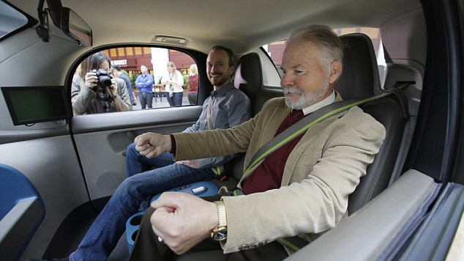
Resources & Capabilities Summary
When analysing a company, it is important to analyse its Resources & Capabilities
Together, they can tell where a company hides its potential.
Resources are everything the company owns .They can be divided into:
  Tangible Resources.
  Intangible Resources.
  Human Resources.
Capabilities are what the company can do with its Resources
To think that one of them is more important than the other is a common mistake
Resources need Capabilities and Capabilities without Resources is nonsense
  No matter how powerful a car is: without a driver it is just a bunch of steel
Image Source: dailymail.co.uk/sciencetech/article – The blindman convinced Google launch self-driving car firm, Steve Mahan revealed person ride without Google engineer onboard,13th December 2016

Slide 18
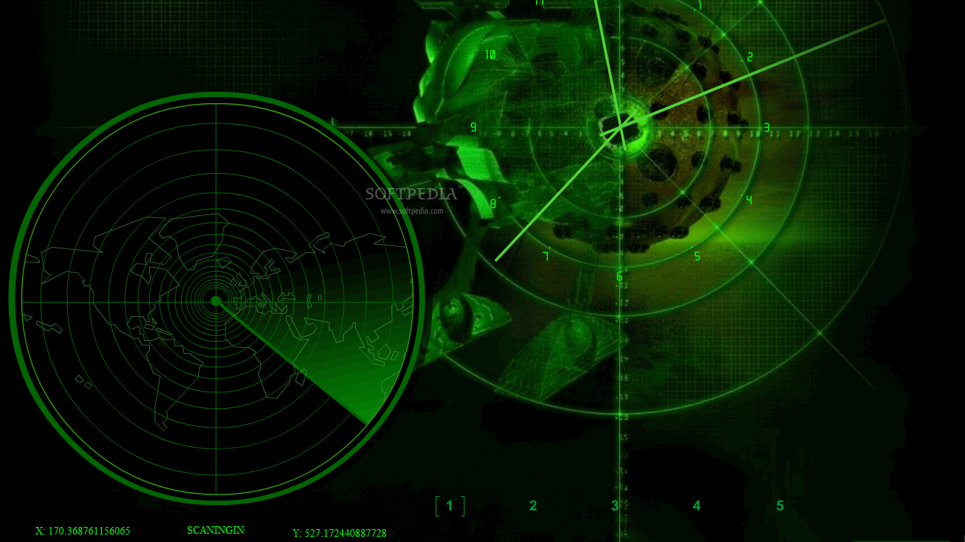
Scanning the Environment

Slide 19
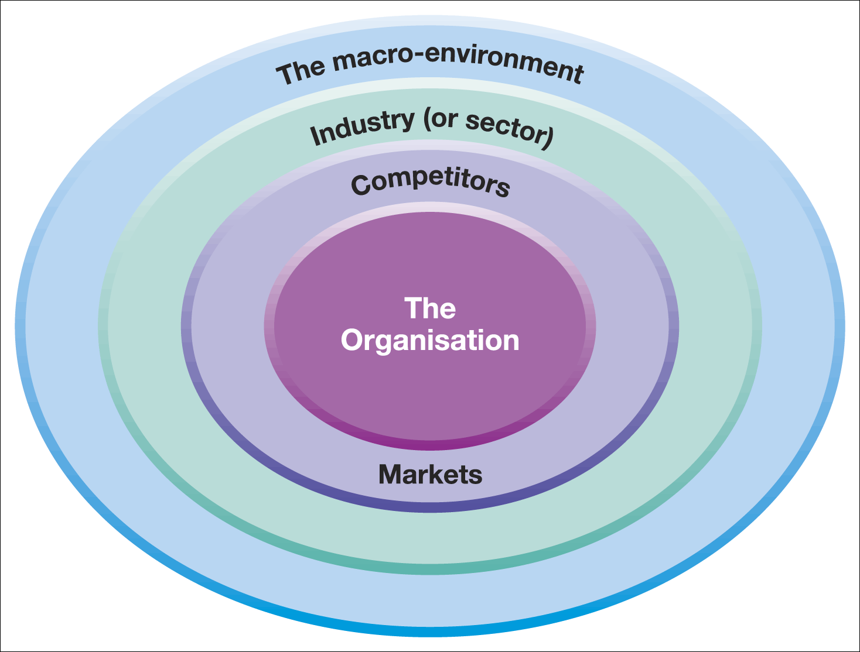
Analysis Tools
Business Environment Layers
PESTLE
Strategic Groups
Five Forces

Slide 20

Analysis Tools
Layers of the Business Environment
PESTLE
  The Marco Environment
Five Forces
  Industry (or Sector)
Strategic Groups
  Competitors
  Markets
Strategic Capabilities
  The Organisation

Slide 21
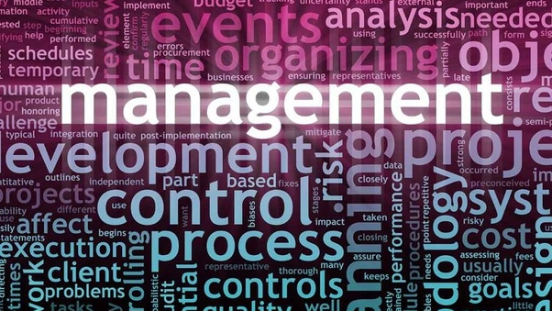

Slide 22
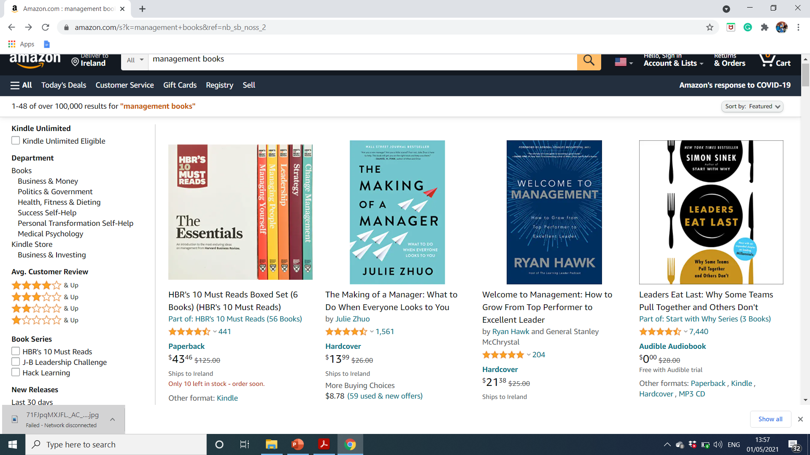

Slide 23

What is Management
Management is getting things done through others
All managers work in organisations
Organizations are collections of people who work together
Management is the coordination of their actions to achieve the goals of the organisation
Management is planning, organizing, leading and controlling of human & other resources to achieve organizational goals effectively and efficiently
Managers get things done through the organisation
Create right systems and environment
Organizations need good managers

Slide 24

Management Skills
Three categories of skills:
    Conceptual,
    Human
    Technical
The degree of the skills may vary but all managers must possess the skills
The application of management skills change as managers move up the hierarchy

Slide 25
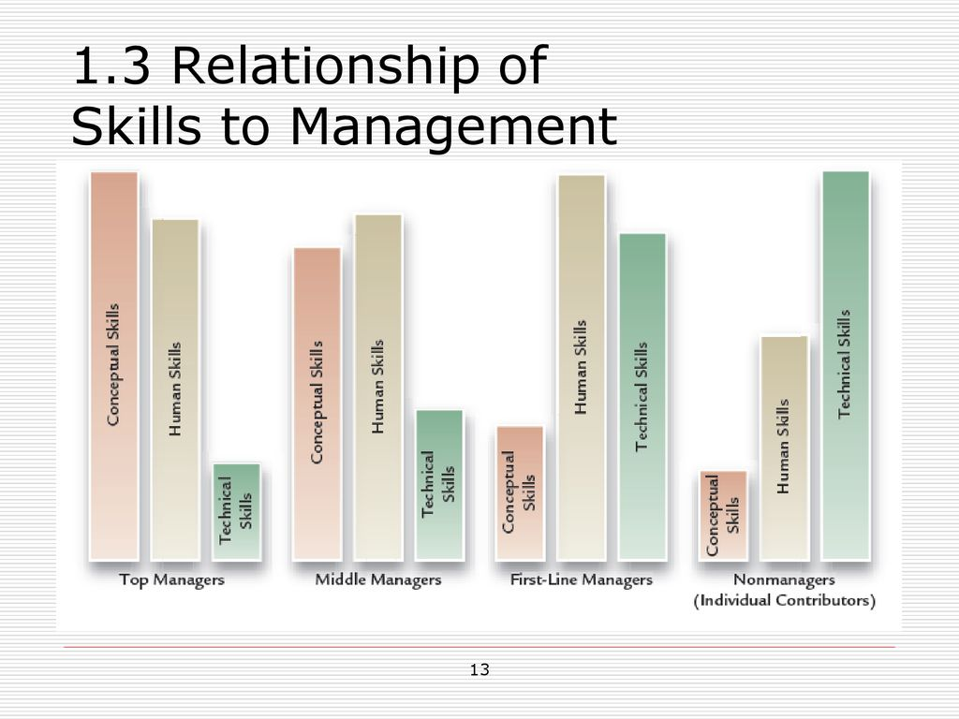
Relationship of Skills to Management

Slide 26
What Do Managers DO? (Murray, 2010)
Set Objectives
Establish goals for the group and decide what must be done to achieve them
Organise
Divide work into manageable activities and select people to accomplish tasks
Motivate & communicate
Create teamwork via decisions on pay, promotion, etc and through communication
Measure
Set targets and standards
Appraise performance
Develop People
Recognise the value of employees
Develop this critical organisational asset

Slide 27
The Process of Management
Management Functions
Planning
Select goals and how to attain them
Leading
Use to influence to motivative them
Controlling
Monitor activities and make corrections
Organising
Assign responsibilities for task accomplishment
Performance
Attain goals
Products
Services
Efficiency
Effectiveness
Resources
Technology
Financial
Raw materials
Information

Slide 28

Organisational Performance
Organisation
  Social entity that is goal directed and deliberately structured
Organisational Effectiveness
  Providing a product or service that customers value
Organisational Efficiency
  Amount of resources used to achieve an organizational goal

Slide 29
Management Styles
Ideas | Experience | Facts
Intuiting | Practical | Analytical
Heart | Hands | Head
Strategies | Processes | Outcomes
Inspiring | Engaging | Informing
Passionate | Helpful | Reliable
Novel | Realistic | Determined
Imagining | Learning | Organising
Seeing it | Doing it | Thinking it
‘The possibilities are endless’ | ‘Consider it done’ | ‘That’s Prefect’

Slide 30
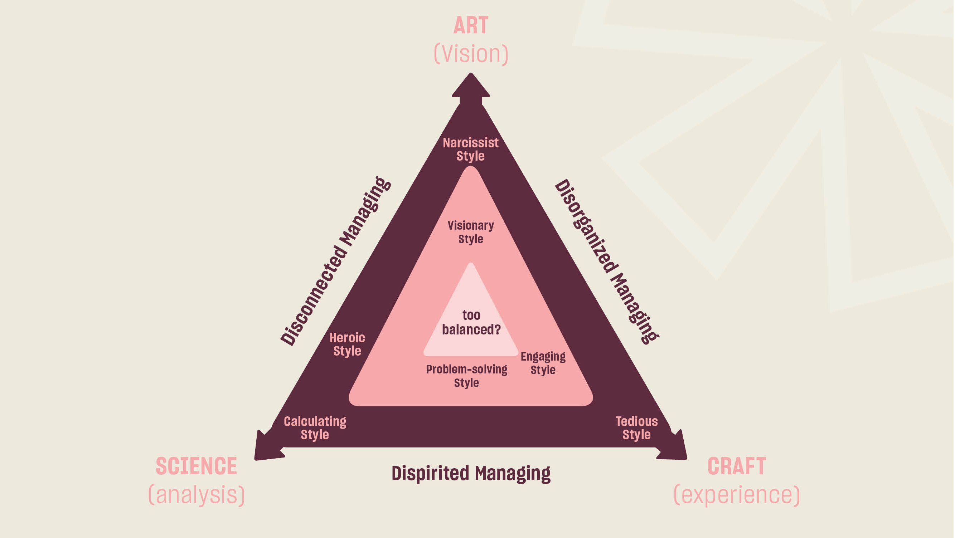
Source: Mintzberg, H. (2009), Managing, London, Prentice Hall.
www.changeboard.com/ where do you sit on Mintzberg’s arts science, craft triangle?

Slide 31
Mintzberg & Patwell (2008)
Heroic Style
An all-knowing, all-powerful person who figures everything out
Sets everything in motion
Makes sure everything gets done
In short, a hero
Visionary Style
Frequently associated with entrepreneurs
This is a style based on creativity, but solidly rooted in experience
Often associated with charismatic and dramatic personalities
Problem-solving Style
Strong blend of analysis (science) and experience (craft) with some reliance on insights (art)
Common style among first line operating managers, foremen, supervisors and project managers
Engaging Style:
Blend of mostly craft with some art thrown in and enough science to provide a reality check
People who practice this style engage in coaching, mentoring and facilitating in a business context they know from deep, first-hand experience

Slide 32
The Functions of Management
Five Management Functions
Planning
Leading
Organising
Controlling
Staffing

Slide 33
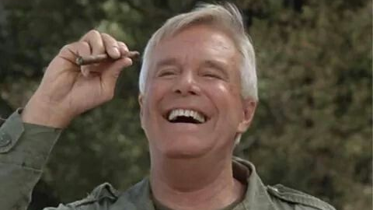
Planning
An ongoing step, and can be highly specialized based on
  Organizational goals
  Division goals
  Departmental goals
  Team goals
It is up to the manager to recognize which goals need to be planned within their individual area
“I love it when a plan comes together” John "Hannibal" Smith, The A-Team

Slide 34
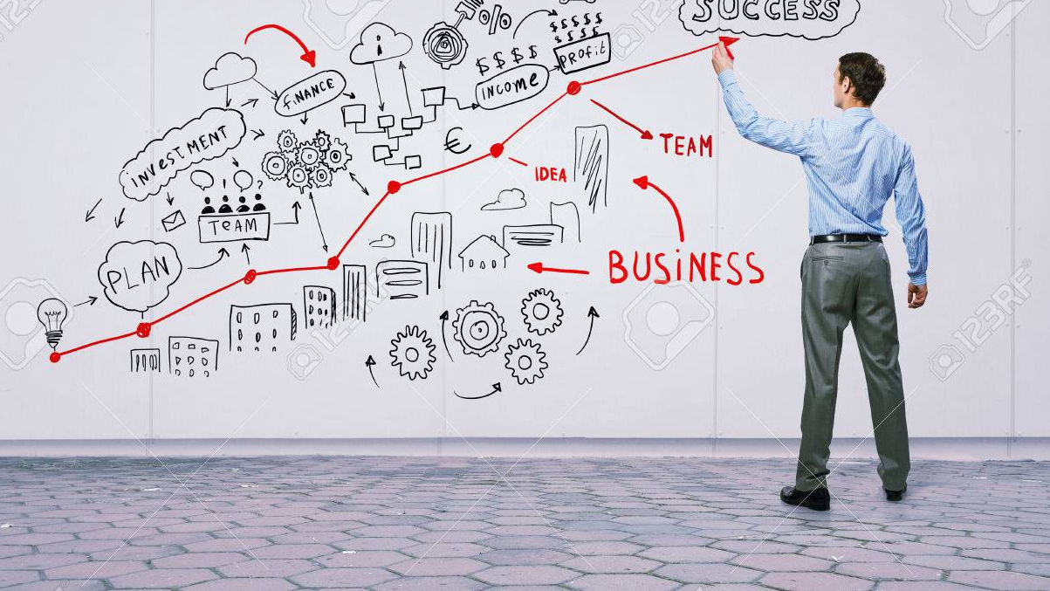
Leading
Goes beyond simply managing tasks
It involves communicating, motivating, inspiring, and encouraging employees towards a higher level of productivity
Not all managers are leaders
An employee will follow the directions of a manager because they have
An employee will voluntarily follow the directions of a leader because they believe in who he or she is as a person, what he or she stands for, and for the manner in which they are inspired by the leader

Slide 35

Organising
Manager determines how s/he will distribute resources and organise employees according to the plan
The manager will need to identify different roles and ensure that adequate resources are assigned to implement the plan
The manager will also need to delegate authority, assign work, and provide direction so that the team can work towards the objective

Slide 36

Controlling
Ensuring all other functions of the organization are in place and are operating successfully
Controlling involves establishing performance standards and monitoring the output of employees to ensure each employee’s performance meets those standards
The controlling process often leads to the identification of situations and problems that need to be addressed by creating new performance standards
The level of performance affects the success of all aspects of the organisation

Slide 37

Staffing
Controls all recruitment and personnel needs of the organisation
The main purpose of staffing is to hire the right people for the right jobs to achieve the objectives of the organisation
Staffing involves more than just recruitment
Also encompasses training and development, performance appraisals, promotions and transfers
Without the staffing function, the business would fail because the business would not be properly staffed to meet its goals

Slide 38
Horizontal & Vertical Management Types
Vertical
Top Managers
Responsible for the entire organization
Middle Managers
Responsible for business units
Project Managers
Responsible for misinterpreting signals
First-line Managers
Responsible for production of goods and services
Horizontal
Functional Managers
Responsible for departments that perform specific tasks
General Managers
Responsible for several departments

Slide 39
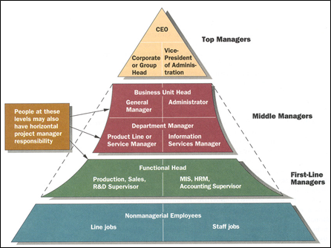
Management Levels
Source: Adapted from Thomas V. Bonoma and Joseph C. Lawler, “Chutes and Ladders: Growing the General Manager,” Sloan Management Review (Spring 1989), 27-37.

Slide 40
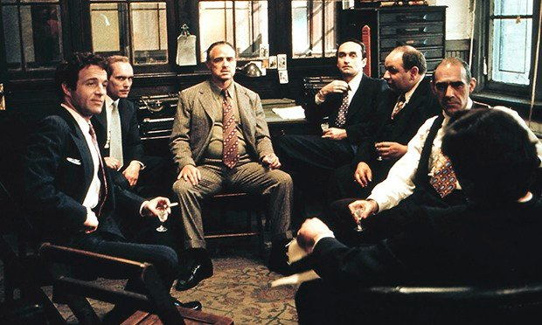
Management Levels
Top Level
Middle Level
First Level

Slide 41
Top Management
Set objectives
Scan the environment
Plan and decision-making
Middle Management
Report to top management
Oversee first level management
Develop and implement activities
Allocate resources
First Level Management
Report to middle management
Supervise employees
Coordinate activities
Day-to-day management

Slide 42

Top Level Management
Consists of board of directors, chief executive or managing director
Ultimate source of authority and it manages goals and policies for an enterprise
It devotes more time on planning and coordinating functions

Slide 43
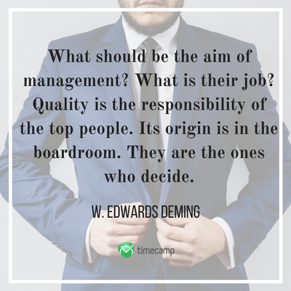
Top Management Role
Lays down the objectives and broad policies of the enterprise
Issues necessary instructions for preparation of department budgets, procedures, schedules etc.
Prepares strategic plans & policies for the enterprise
Appoints the executive for middle level i.e. departmental managers
Controls & coordinates the activities of all the departments
Responsible for maintaining a contact with the outside world
Provides guidance and direction.
Responsible towards the shareholders for the performance of the enterprise

Slide 44

Middle Level Management
Branch, departmental, area managers etc.
Responsible to the top management for the functioning of their department
Devote more time to organisational and directional functions
In small organization, may be only one layer of middle level of management but in big enterprises, there may be senior and junior middle level management
“Watch the growth of middle level management. Don't automatically fill vacant jobs. Leave some positions unfilled for 6-8 months to see what happens. You will find you won't need to fill some of them.“ (Donald Rumsfeld)

Slide 45

Supervisory/Operative Management
Consists of supervisors, forepersons, section officers, team leaders etc.
According to R.C. Davis, “Supervisory management refers to those executives whose work has to be largely with personal oversight and direction of operative employees”
In other words, they are concerned with direction and controlling function of management

Slide 46

Middle Management Role
Execute the plans of the organization in accordance with the policies and directives of the top management
Make plans for the sub-units of the organization
Participate in employment & training of lower level management
Interpret and explain policies from top level management to lower level
Responsible for coordinating the activities within the division or department
Sends important reports and other important data to top level management
Evaluate performance of junior managers
Responsible for inspiring lower level managers towards better performance

Slide 47
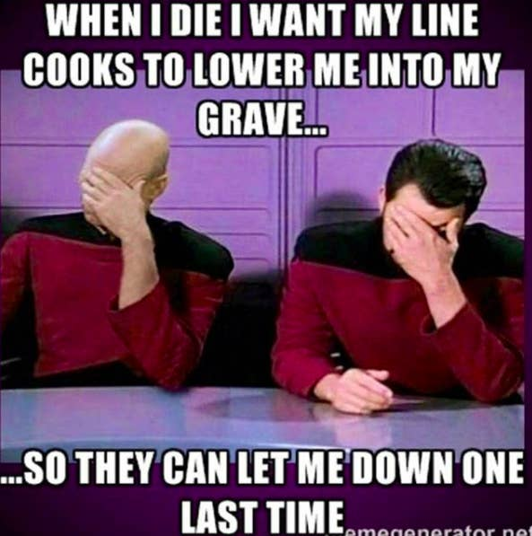
Supervisory/Operative Management Role
Assign jobs and tasks to various workers
Guide and instruct workers for day to day activities
Responsible for the quality as well as quantity of production
Entrusted with the responsibility of maintaining good relations in the organization
Communicate workers problems, suggestions, and recommendatory appeals etc to the higher level and higher level goals and objectives to the workers
Help to solve the grievances of the workers
Supervise & guide the sub-ordinates
Responsible for providing training to the workers
Arrange necessary materials, machines, tools etc for getting the things done
Prepare periodical reports about the performance of the workers
Ensure discipline in the enterprise
Motivate workers
Image builders of the enterprise because they are in direct contact with the workers

Slide 48
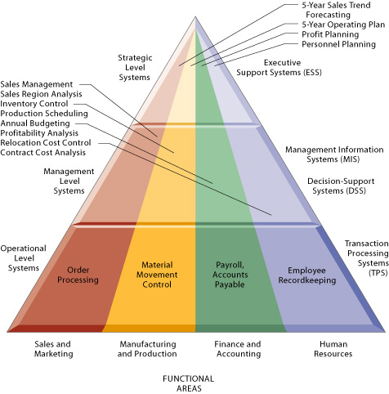
Information for Managers
Loudon & Loudon (1998), Types of Information Systems
Top Managers
    Frequently formulate and control strategy but may also involve others in the process
Middle and Lower Level Managers
    Have to meet strategic objectives and deal with constraints
All Managers
    Communicate strategy to their teams
    Contribute to the formation of strategy through ideas and feedback
https://paginas.fe.up.pt/~acbrito/laudon/ch2/chpt2-1fulltext.htm

Slide 49
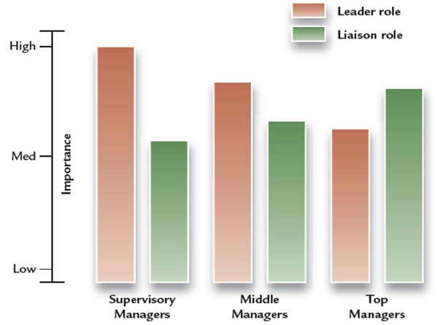
Hierarchical Levels and Importance of Leader and Liaison Roles
Source: C. Christopher Lee, Ph.D, (2013) Introduction to management: innovate management in a changing world

Slide 50
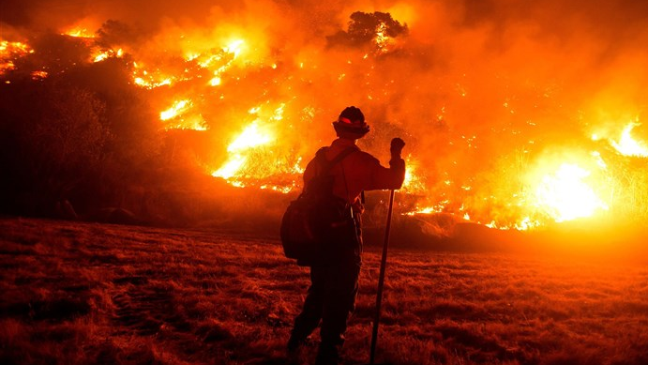
Making the Leap: Becoming a New Manager
Organisations often promote star performers to management
Becoming a manager is a transformation
Move from being a doer to a coordinator
Many new managers expect more freedom to make changes
Successful managers build teams and networks
Many make the transformation in a “trial by fire”

Slide 51
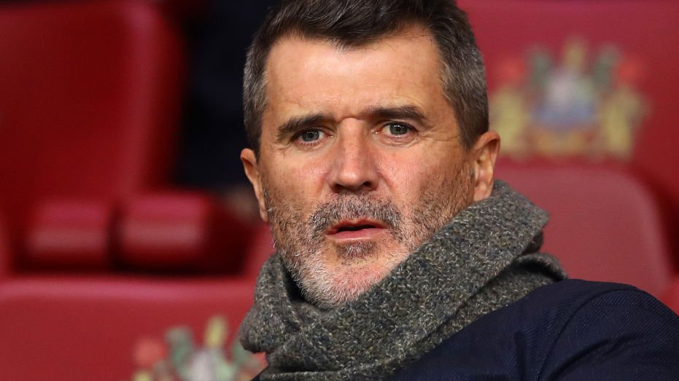
Do You Want To Be A Manager?
Increased workload
The challenge of supervising former peers
The headache of responsibility for other people
Being caught in the middle
Make more money
Creating opportunity to make change/difference
Respect
Honour

Slide 52
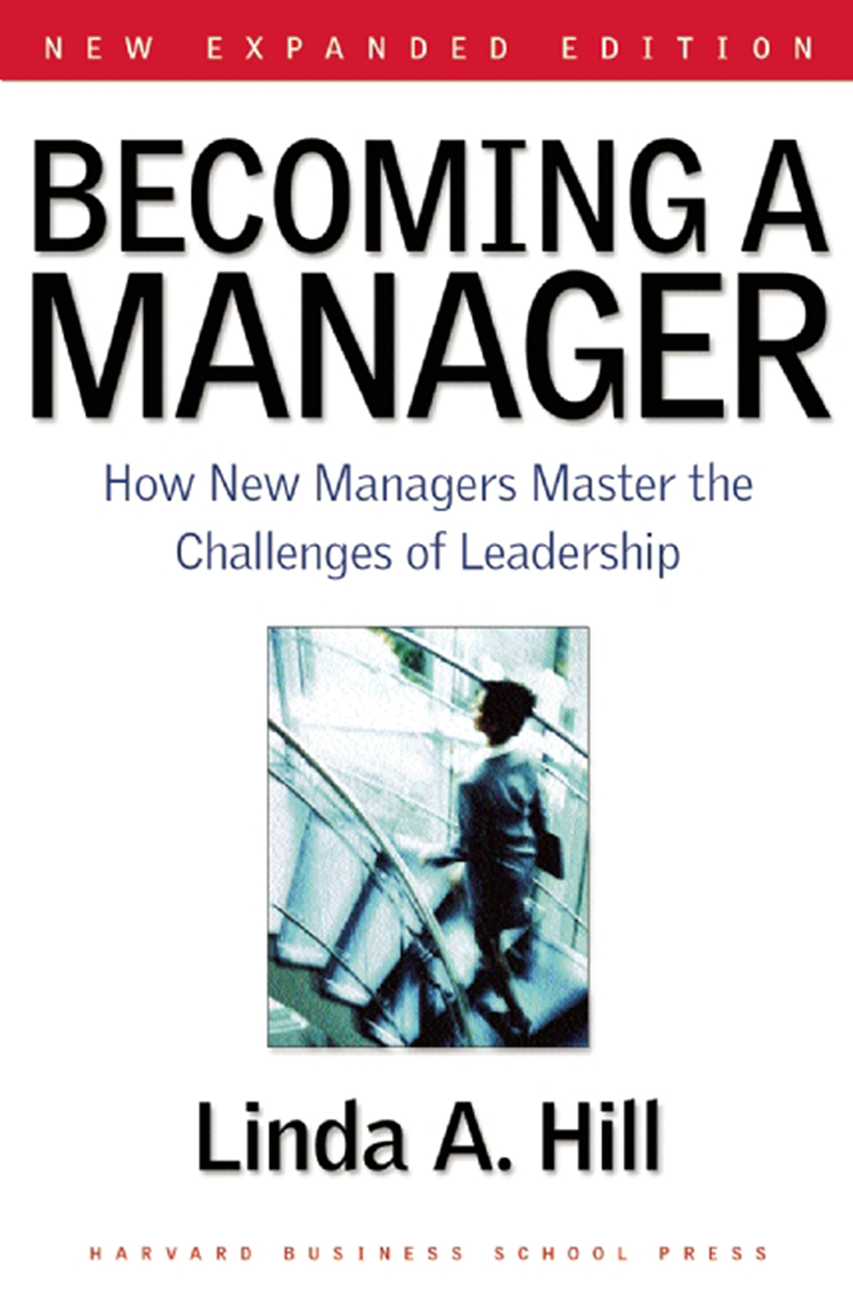
Manager Activities
Manager roles are important to understand but they are interconnected, i.e. not discrete activities
Managers need time to plan and think strategically
Adventures in multitasking
    Activity characterized by variety, fragmentation and brevity
    Less than nine minutes on most activities
    Managers shift gears quickly
Life on speed dial
    Work at unrelenting pace
    Interrupted by disturbances
    Always working (catching up)

Slide 53
Making the Leap from Individual Performer to Manager
From Individual Identity
Specialist; preform specific tasks
Gets things done through manly own effort
An individual actor
Works relativity independently
To Manager Identity
Generalist; coordinates diverse tasks
Gets things done through others
A network builder
Works in a highly interdependent manner

Slide 54
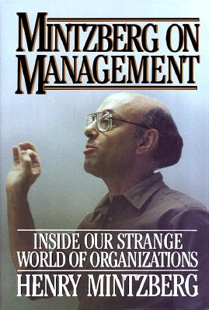
The Nature of Managerial Work (Mintzberg)
A role is a set of specific tasks a person performs because of the position they hold
Roles are directed inside as well as outside the organisation
There are 3 broad role categories
    Interpersonal
    Informational
    Decisional

Slide 55
Interpersonal Roles
Roles managers assume to coordinate and interact with employees and provide direction to the organization
Figurehead role: symbolizes the organization and what it is trying to achieve
Leader role: train, counsel, mentor and encourage high employee performance
Liaison role: link and coordinate people inside and outside the organization to help achieve goals
Informational Roles
Associated with the tasks needed to obtain and transmit information for management of the organization
Monitor role: analyses information from both the internal and external environment
Disseminator role: manager transmits information to influence attitudes and behaviour of employees
Spokesperson role: use of information to positively influence the way people in and out of the organization respond to it
Decisional Roles
Associated with the methods managers use to plan strategy and utilize resources to achieve goals
Entrepreneur role: deciding upon new projects or programs to initiate and invest
Disturbance handler role: assume responsibility for handling an unexpected event or crisis
Resource allocator role: assign resources between functions and divisions, set budgets of lower managers
Negotiator role: seeks to negotiate solutions between other managers, unions, customers, or shareholders
  Source Adapted from; Mintzberg, H. (1973). The Nature of Managerial Work. New York: Harper & Row and Managerial Work: Analysis from Observation Henry Mintzberg Management Science, Vol. 18, No. 2, Application Series. (Oct., 1971), pp. B97-B110.

Slide 56
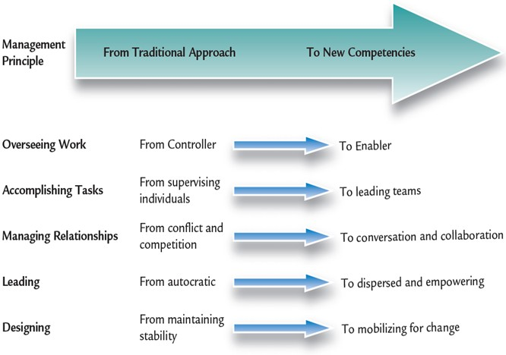
State-of-the-Art Management Competencies for Today’s World
Source: C. Christopher Lee, Ph.D, (2013) Introduction to management: innovate management in a changing world

Slide 57

When Skills Fail
Unethical behaviour has been in the media
During turbulent times, managers must apply their skills
Common management flaws:
  Not listening to customers
  Misinterpreting signals from marketplace
  Not building teams
  Inability to execute strategies
  Failure to comprehend and adapt to change
  Poor communication and interpersonal skills

Slide 58
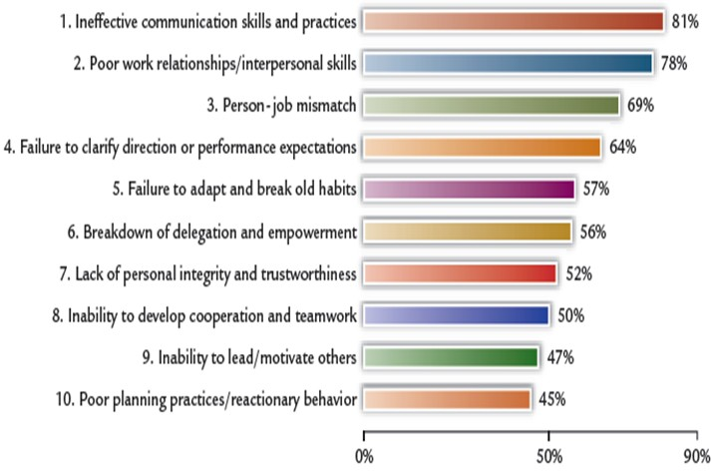
Top Causes of Manager Failure
(Logenecker, Neubert & Fink, 2007)
Source: C. Christopher Lee, Ph.D, (2013) Introduction to management: innovate management in a changing world

Slide 59

Innovative Management for the New Workplace
Rapid environmental shifts:
    Pandemic
    Technology
    Globalization
    Shifting social values
In the new workplace, work is free-flowing, complex and flexible
  Success depends on innovation and continuous improvement

Slide 60

Future Management Competencies
Greater collaboration across functions, levels, customers, and companies
Riskier experimentation and learning are key values
Knowledge management and information sharing
More challenges and changes are on the horizon!
An exciting time in management

